Slide 1
FROM FASTQ TO BAM
Why and how to align reads to a reference
JOSE DE VEGA
jose.devega@earlham.ac.uk

Slide 2
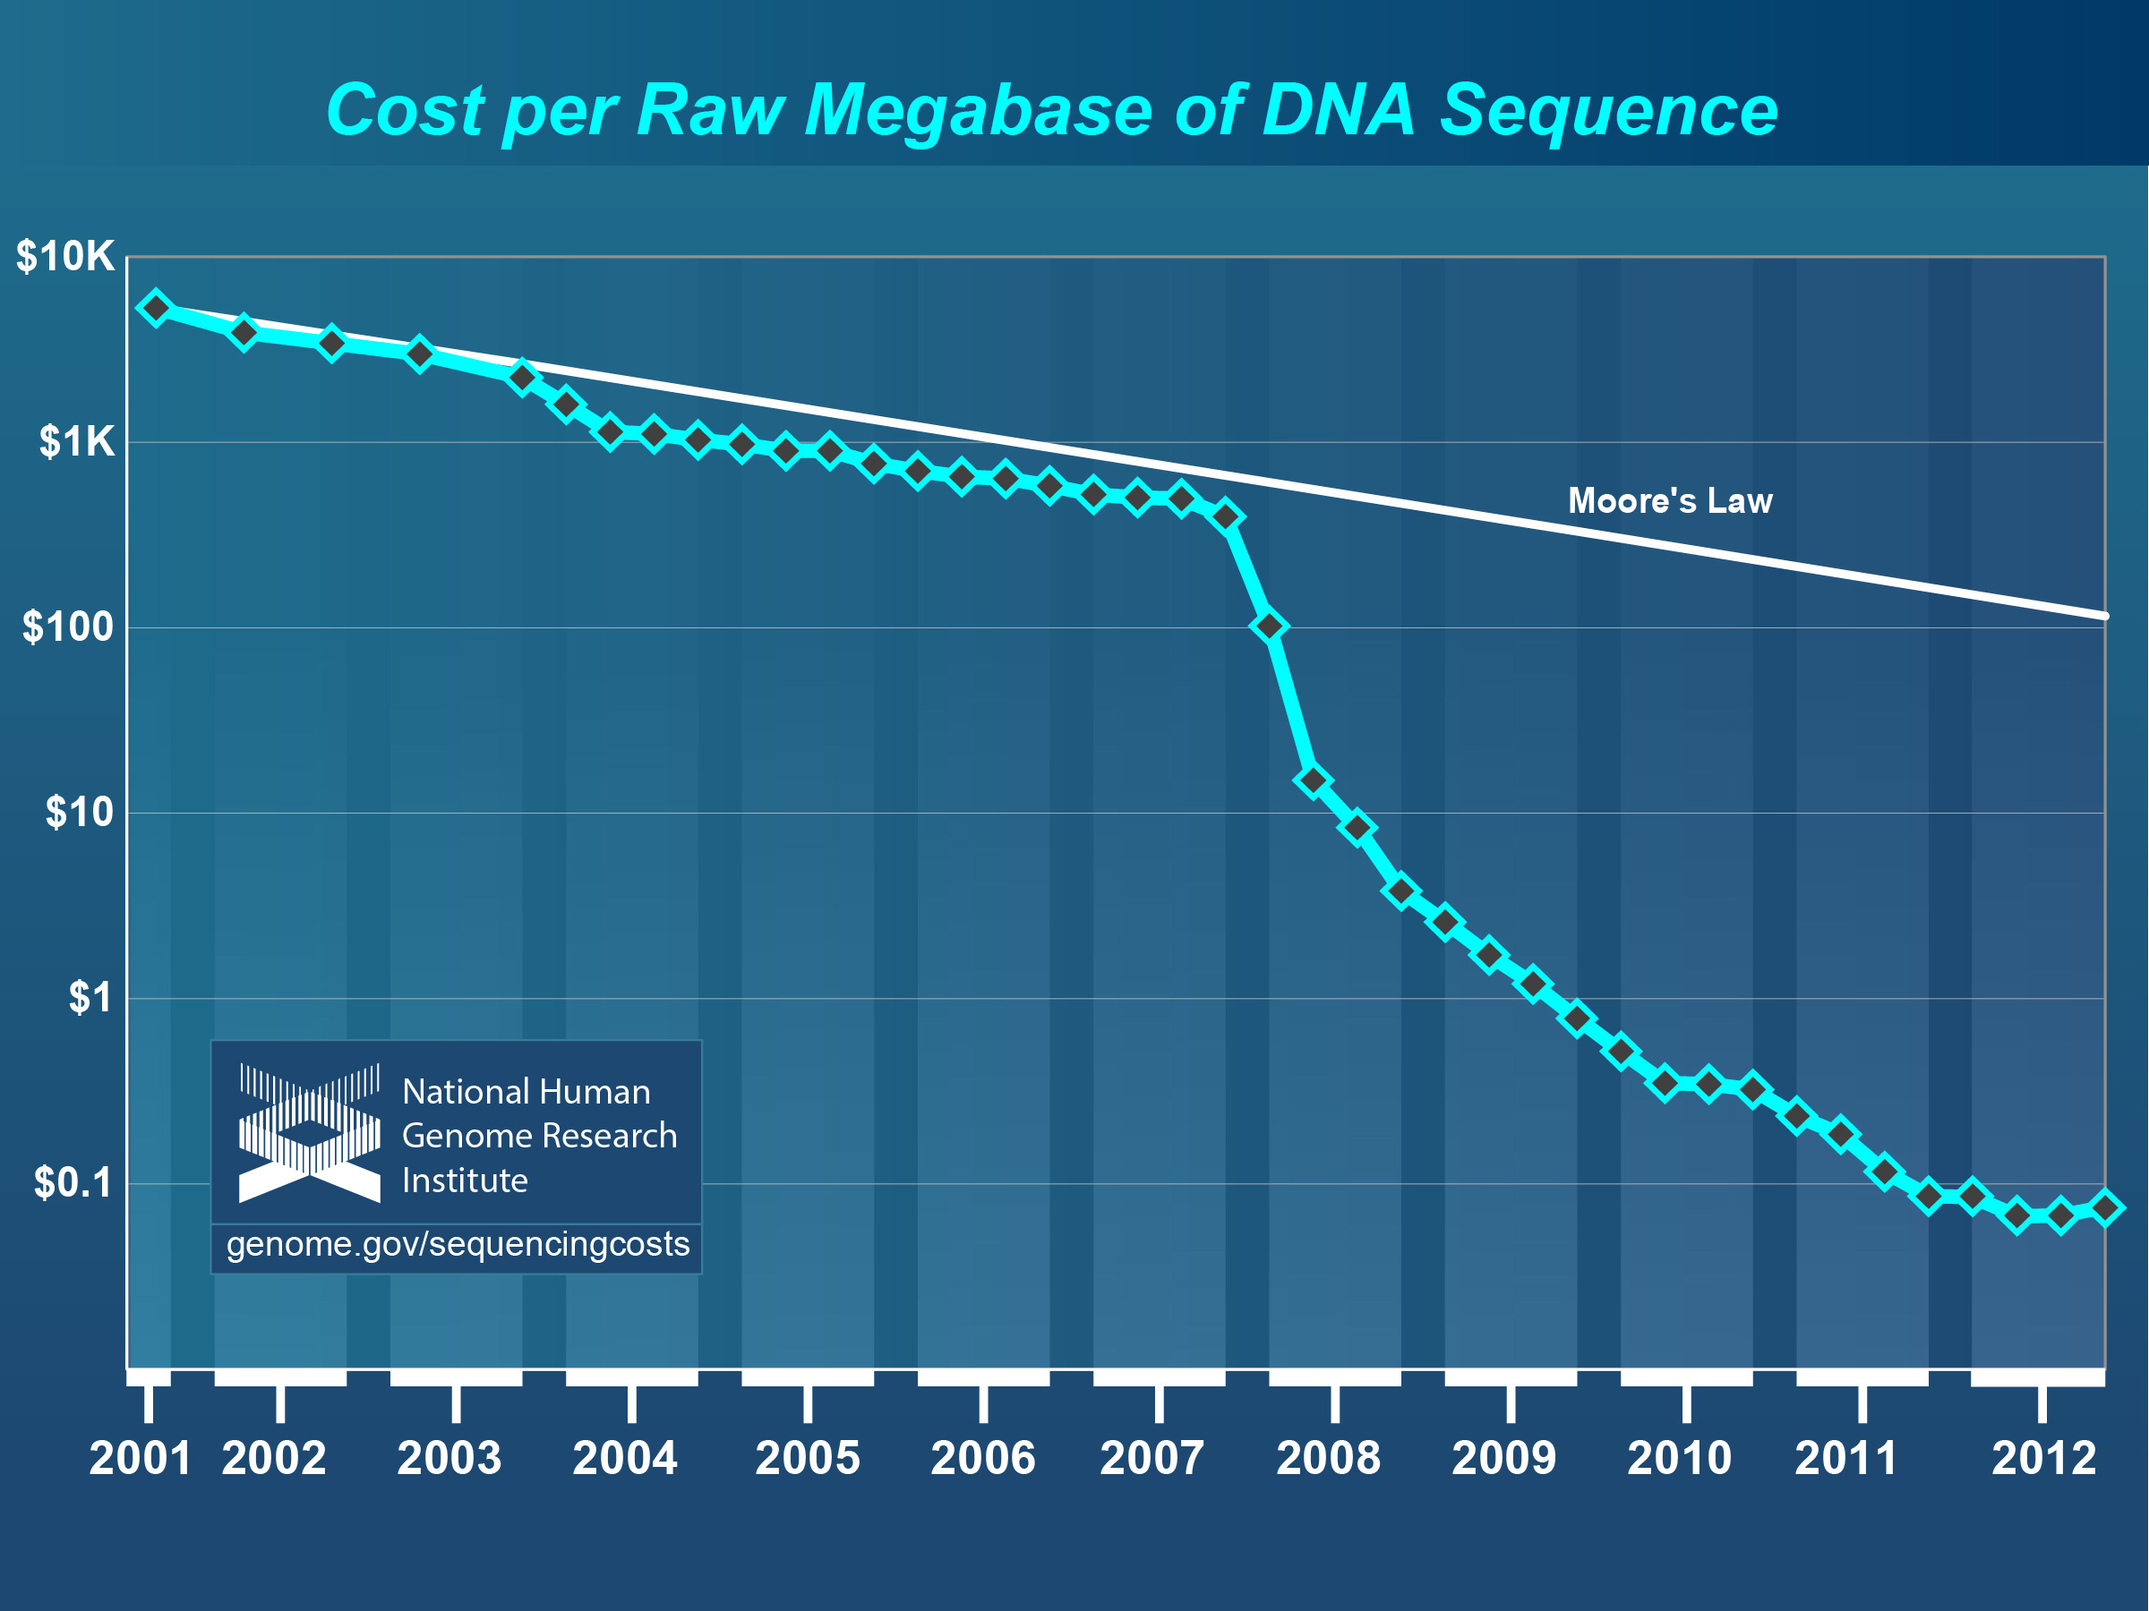
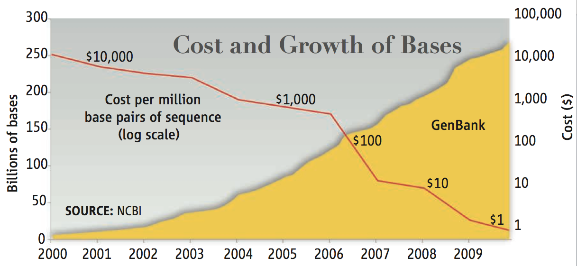
Growth of sequencing
Science 331 (11 Feb 2011)

Slide 3
FASTQ file
4 lines per read
Stores sequence and quality
Read ID
@HWI-ST790:234:D0W8BACXX:1:1101:1792:2000 1:N:0:GCCAA
ACNATTAACAACCTTGGTGTTCAGCATGAGAACTTATCTGCAGCTGAGTCTCGTATCCGTGACG
+
CC#4ADDFHHHHHIIIIEGHIIIIIIIIIIGIIIIIIIIIIIIIIIIIDGHHIDHHIII6@FGI
@HWI-ST790:234:D0W8BACXX:1:1101:2592:1999 1:N:0:GCCAA
CTNGAATGCAGGTAGAATACATCTCCCGGATAAGCCTCGCGGCCCCCGGGGCGGGGGGGGAGAG
+
:=#44AA?:<DFFE>FED?3A<EHH>FIF?ADGCGBA?D#########################
@HWI-ST790:234:D0W8BACXX:1:1101:4221:1999 1:N:0:GCCAA
GGNAAATACGAAAGATAAGCTACGCAAGAAACGAAGGATTACTGCGAAAGGCTGCGATGCGGCA
+
@@#4=BDDFDFHDIIBGIHHHIGGIIIBHHIF=ABB@?B<DE@BF<FHH@@EHACD<B3=8@:B
Sequence
Quality

Slide 4
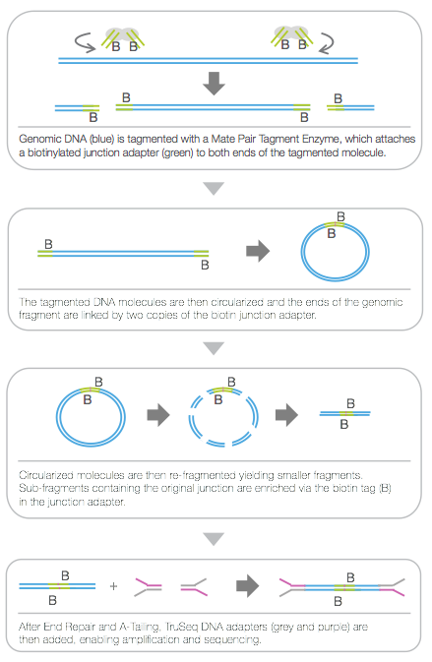
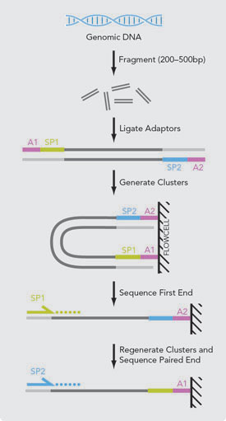
Paired reads
Illumina Paired reads (PE)

Slide 5
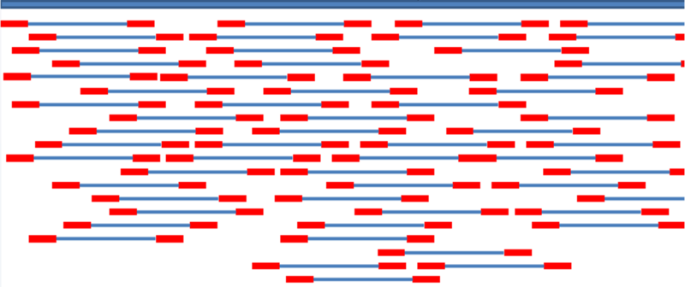
What is mapping?
Place a read or pair of reads in their original position in the reference sequence

Slide 6
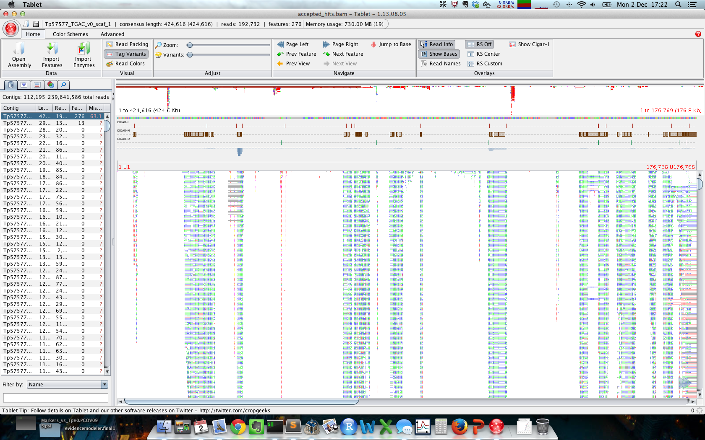
What is mapping?
We could align the reads to the reference using “classic” aligners…
…but we need new tools to handle the massive quantity of data produced by NGS platforms.
http://bioinf.scri.ac.uk/tablet/
(Open source)

Slide 7

What is mapping?
GENOME
TRANSCRIPTOME
transcript A
transcript B

Slide 8
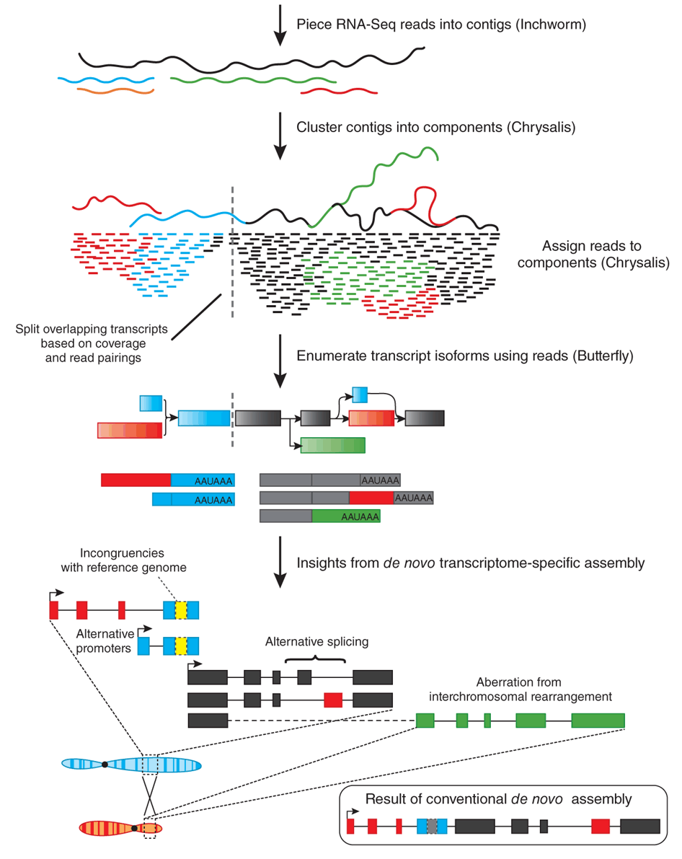
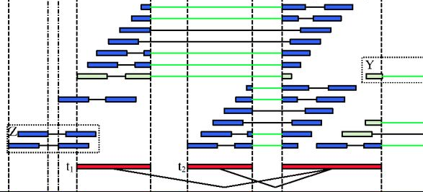
Why…?
An accurate placement of the reads is crucial in most of the NGS workflows
Transcriptome assembly
De novo
(trinity)
Genome-guided
(tophat + cufflinks)
Grabherr et al (2011) Nat Biotech 29:644-652
Bao et al (2013) Bioinformatics 29(10):1250-1259

Slide 9
Why…?
An accurate placement of the reads is crucial in most of the NGS workflows
Genome sequencing

Slide 10
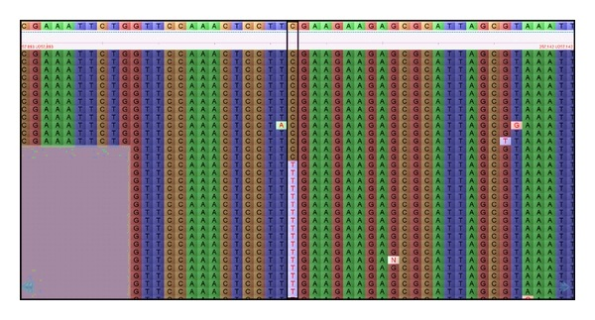

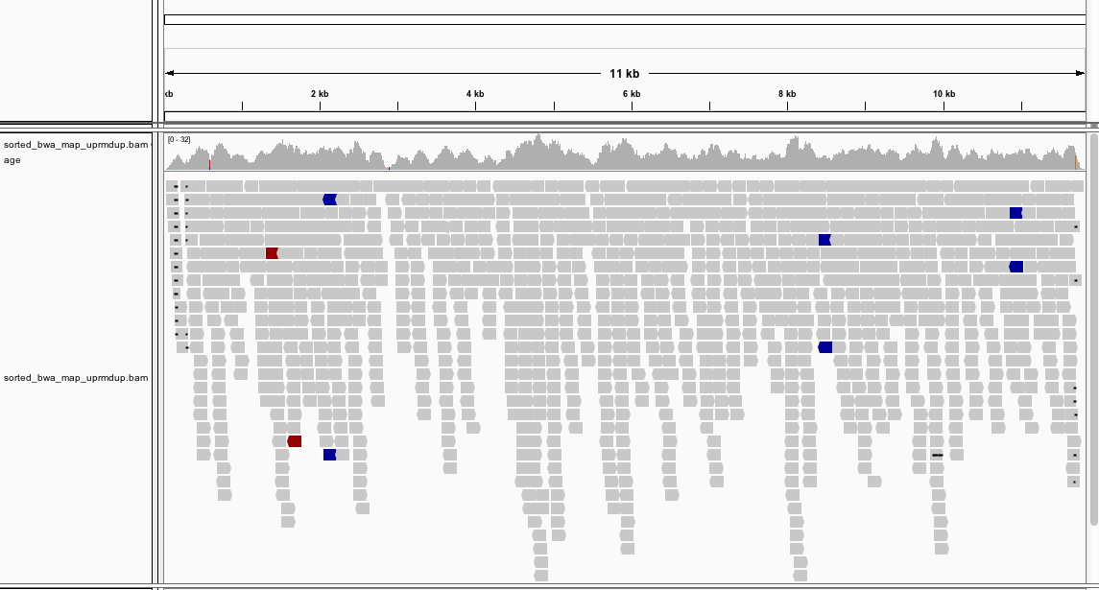
Why…?
SNPs detection
Dharanya Sampath

Slide 11
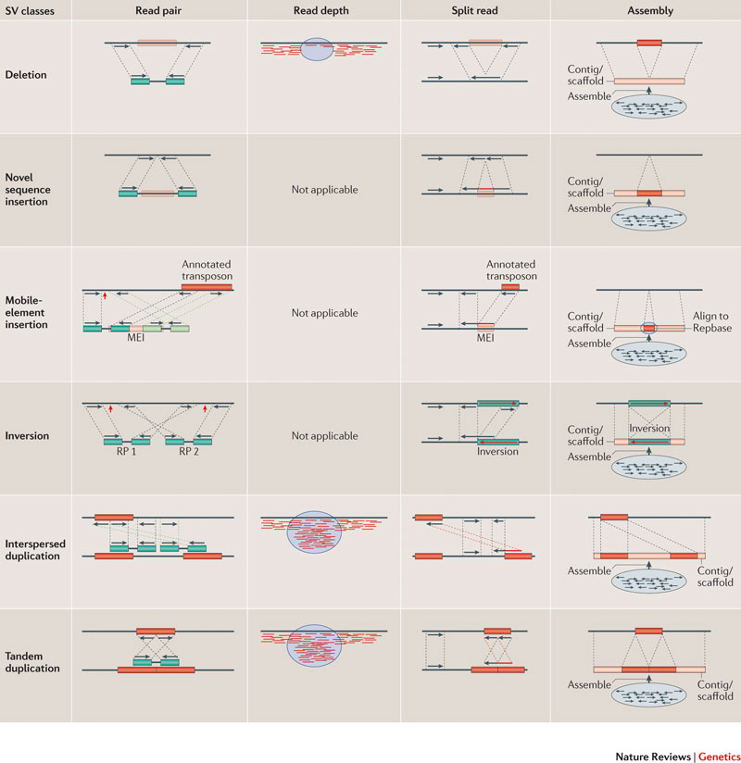
Why…?
Structural variants detection
Or insertion:
Alkan et al. (2011) Nature Rev Genet 12: 363-376

Slide 12
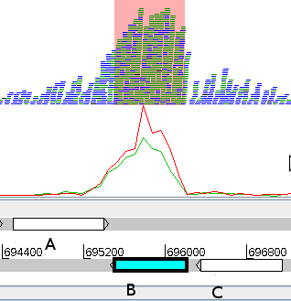
Why…?
RNA-Seq
REFERENCE GENOME

Slide 13
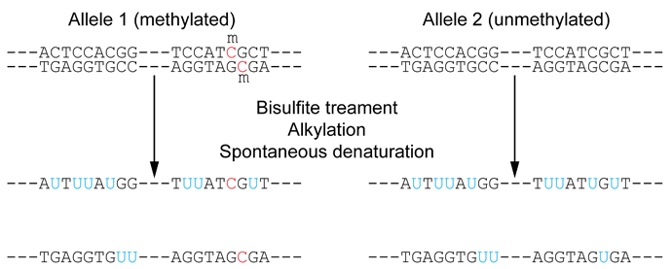
Why…?
DNA methylation
Methylated region
Blue boxes = Cytosines
Unmethylated region
Cokus et al. 2008. Nature 453, 215-219

Slide 14
How… ?
Fast and accurate aligners designed to handle millions of short reads
Engstrom et al. (Nov 2013) Nat Methods 425: 1185-1193
Hatem et al. (2013)
BMC Bioinf 14:184

Slide 15
How… ?
There is a trade-off between speed and quality
Ignore quality scores
Limit the number of missmatches
Ignore SNPs
Ignore gaps or limit gap lengths
Non spliced-aware aligners
(BLAST / BLAT)
Bowtie
Novoalign
SOAP, abyss, velvet…
Most of the aligners…
Spliced-aware aligners
(Exonerate)
Tophat
BWA
MapSplice
GMAP/GSNAP
…
REFERENCE GENOME

Slide 16
How…? Basic pipeline
Reads
(fastq)
Aligns
(sam/bam)
Aligner
(bwa, bowtie…)
Reporting
options
Indexed
Reference
(fasta)

Slide 17
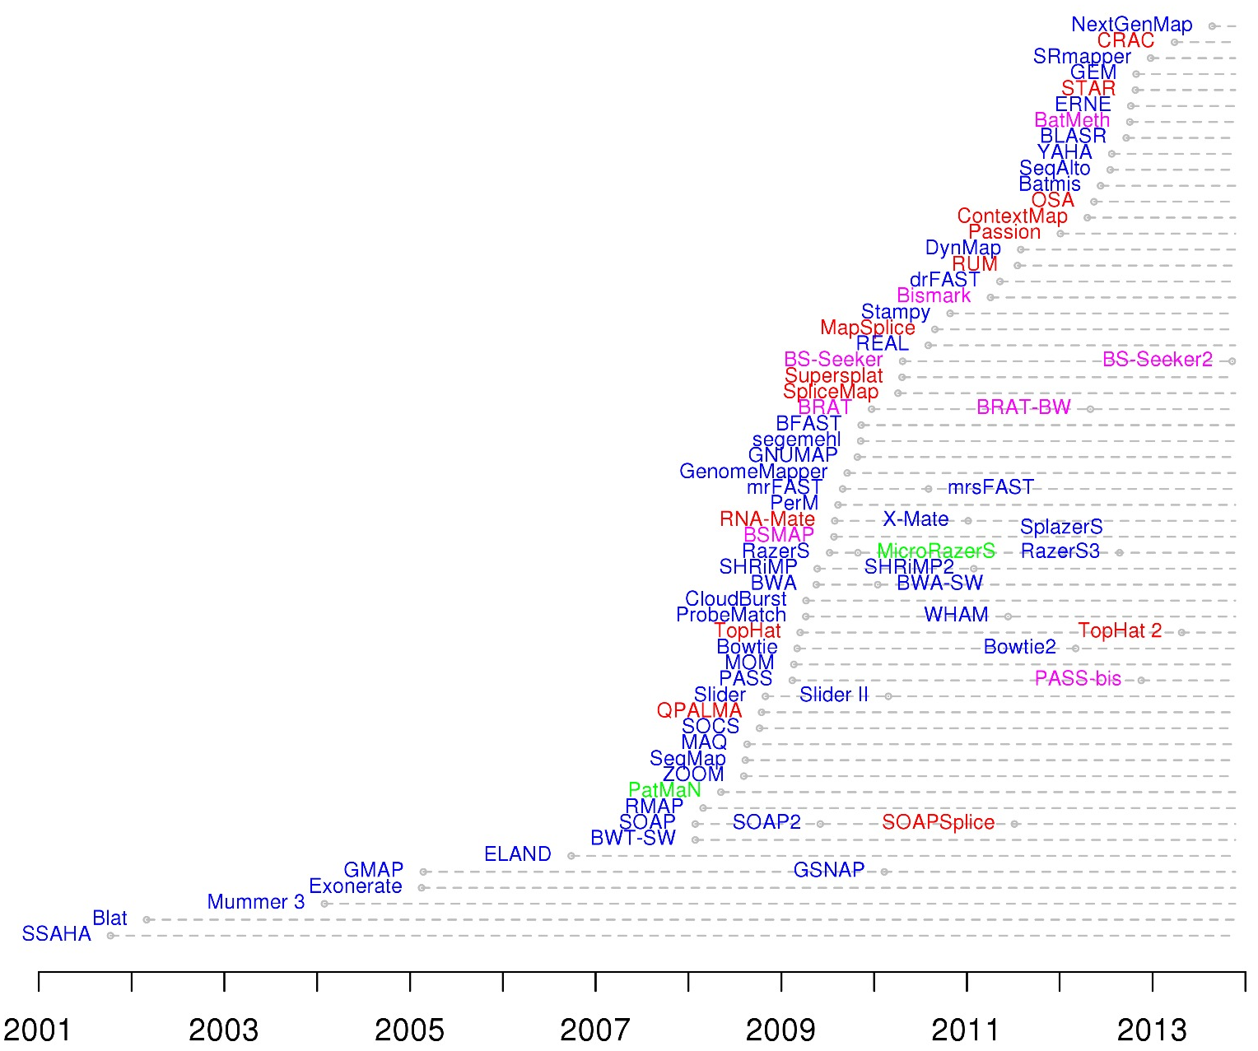
Aligners comparison
http://wwwdev.ebi.ac.uk/fg/hts_mappers/
Fonseca et al. (2012) Bioinformatics 28: 3169-3177
Data = DNA, RNA, miRNA or bisulphite
Availability = Open source, free binary or commercial
Sequencing platform = Illumina, PacBio, Ion torrent…
Output = SAM, Native, TSV…
Indels, GAPs ?
Splicing ?
Global, semiglobal, end-to-end and local aligments
Reporting options
DNA
RNA (Splice-aware)
miRNA
Bisulphite

Slide 18
Global vs. Local alignments
Global alignment
End-to-end alignment
Untrimmed alignment
Unclipped alignment
Local alignment
Trimmed alignment
Clipped alignmet
ACGGTTGCGTTAA-TCCGCCACG
||||||||| ||||||
TAACTTGCGTTAAATCCGCCTGG
GACTGGGCGATCTCGACTTCG
||||| ||||||||||X|||
GACTG--CGATCTCGACATCG
a local alignment of two sequences allow arbitrary-length segments of each sequence to be aligned, with no penalty for the unaligned portions of the sequences
Semiglobal alignments
Glocal aligment

Slide 19
Reporting options
X
X
X
X
X
X
X
Mapping multiple times
X
Mapping once and with one mismath
Mapping more than once but with similar number of mismatches
Mapping more than once and with different number of mismatches
All (-a):
X
X
X
X
X
X
X
Best (--best):
X
X
X
X
X
One random (-k 1):
X
X
X
X
Unique (-m 1):
X
With Maximum (-m 3):
X
X
X
X
X
X
Combinations (-k 1 --best):
X
X
X

Slide 20
Tophat: Features
“A spliced read mapper for RNA-Seq”
Popular
Tuxedo suite
Allow variable-length indels
Known exon/introns junctions can be provided as input
Relatively easy tunning
Open source

Slide 21
tophat (1 / 5)
We will be mapping paired RNA-seq reads to the Arabidopsis chromosome 2 reference.
FIRSTLY, CONNECT TO THE SERVER (SSH)
Unzip and Look at the files in the example dataset devega_ejercicio_tophat.zip:
$ cd tophat_example
$ ls -R
.:
reads reference
./reads:
SRR360147_1.fastq SRR360147_2.fastq
./reference:
Athaliana_chr2.fa Athaliana_chr2_genes.gff

Slide 22
(2 / 5)
Tophat uses Bowtie2 to align reads so first we need to index our reference.
$ cd reference
$ bowtie2-build Athaliana_chr2.fa Athaliana_chr2
Now use TopHat2 to map the reads to the reference.
The distance between the mate-pair reads is 500bp.
Report only alignments with no mismatches.
Discard reads with more than 3 hits.
Don’t report discordant alignments.
Don’t report alignments where only one read in a pair aligns.
Use more than one thread to speed up the mapping.
http://tophat.cbcb.umd.edu/manual.shtml

Slide 23
(3 / 5)
First, check that you are in the right folder: tophat_example
$ tophat2 --mate-inner-dist 500 /
--read-mismatches 0 /
--max-multihits 3 /
--no-discordant /
--no-mixed /
--num-threads 2 /
reference/Athaliana_chr2 /
reads/SRR360147_1.fastq /
reads/SRR360147_2.fastq
Aligning the reads takes approx. 8 minutes with 2 threads
TopHat output files are provided in the tophat_output directory if you want to move to the next stage

Slide 24
(4 / 5)
OUTPUT
For SAM/BAM specification see http://samtools.sourceforge.net/SAMv1.pdf
BED files define an annotation track in a browser, the specification can be found at http://genome.ucsc.edu/FAQ/FAQformat.html#format1
accepted_hits.bam | Aligned reads in BAM format
unmapped.bam | Unmapped reads in BAM format
align_summary.txt | Summary of read alignments
deletions.bed | Deletions reported by TopHat
insertions.bed | Insertions reported by TopHat
junctions.bed | Splice junctions reported by TopHat
prep_reads.info | Details about the reads being mapped

Slide 25
(5 / 5)
Check the alignment summary file. What percentage of your reads align concordantly?
$ cat align_summary.txt
Left reads:
Input: 397289
Mapped: 268353 (67.5% of input)
of these: 4999 ( 1.9%) have multiple alignments (15 have >3)
Right reads:
Input: 394562
Mapped: 265626 (67.3% of input)
of these: 5045 ( 1.9%) have multiple alignments (7 have >3)
67.4% overall read alignment rate.
Aligned pairs: 204296
of these: 805 ( 0.4%) have multiple alignments
and: 40 ( 0.0%) are discordant alignments
51.8% concordant pair alignment rate.

Slide 26
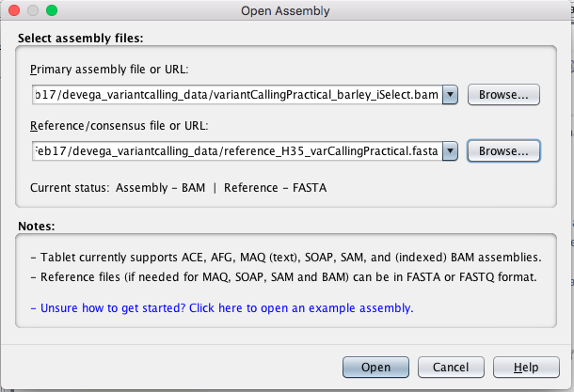
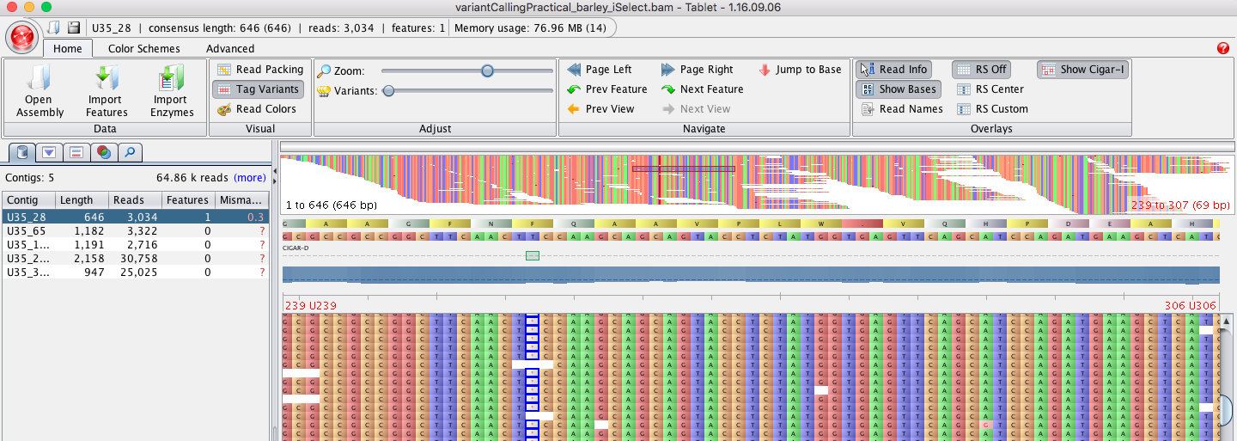
Visualize the alignments with Tablet (https://ics.hutton.ac.uk/tablet/)

